Slide 1
Programming Python
Functions

Slide 2
Learning Objectives
To understand what a function is.
To be able to use a function in a Python program

Slide 3
What are functions?
Functions are a convenient way to divide your code into useful blocks,
Allows us to order our code, make it more readable, reuse it and save some time.
Also functions are a key way to define interfaces so programmers can share their code.

Slide 4
How to write a Function (Python)
Functions in python are defined using the block keyword "def", followed with the function's name as the block name
def my_function():
print("Hello From My Function!")

Slide 5
Functions with arguments
Functions may also receive arguments (variables passed from the caller to the function). For example
def my_function_with_args(username, greeting):
print("Hello, %s , From My Function!, I wish you %s"%(username, greeting))

Slide 6
Functions that return a value to the calling program
Functions may return a value to the caller, using the keyword- 'return' . For example:
def sum_two_numbers(a, b):
return a + b

Slide 7
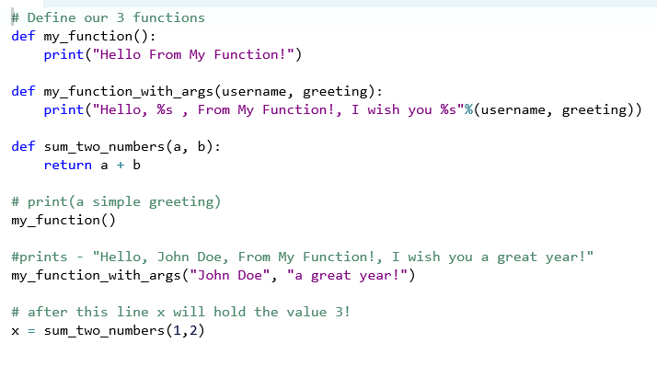
How to call a function in Python!
Simply write the function's name followed by (), placing any required arguments within the brackets. For example, lets call the functions written above (in the previous example):

